Slide 1
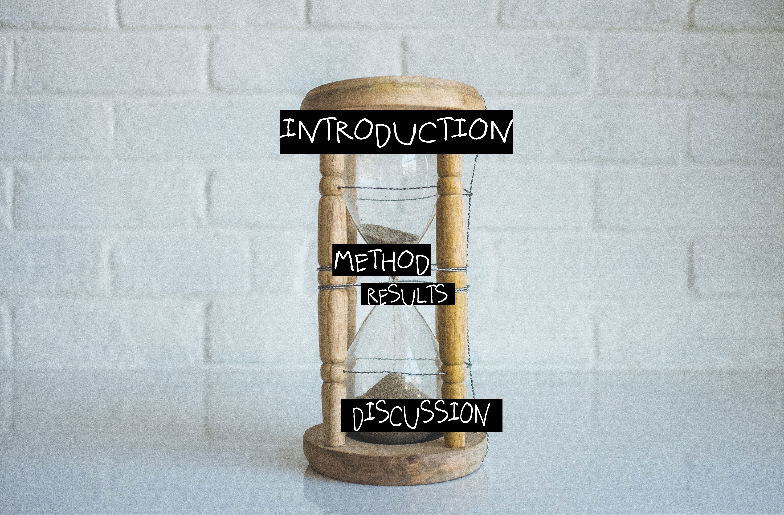
Scientific Writing Using the Hourglass Method Created by Professor Essi Viding and Ruth Roberts for the Rosalind Franklin STEM Ambassadors Workshop For more information visit: www.rosalindfranklinstem.com/scientific-writing
Notes:
Insert logo here

Slide 2
Scientific writing
Evidence
Need to communicate clearly
Why did you do the research?
What did you find out?
How confident can you be of your interpretation of the data?
Others need to be able to replicate the research protocol

Slide 3
Introduction
Method
Results
Discussion
Notes:
Has anyone got experience of writing scientific reports?

Slide 4
Hourglass structure of scientific report
Introduction
Method
Results
Discussion

Slide 5
Introduction
Start with broad context:
Why is it important to
investigate X?
Tell the reader what is
already known.
Tell the reader why you
are conducting your
study, how does it add
to what we know already

Slide 6
Method
How you investigated your question?
Enough detail so others can replicate
Results
What checks did you do on your data?
What did you find?

Slide 7
Discussion
Start by outlining your
findings
How does this compare
with previous findings?
Did you learn something
new? Limitations?
What do the findings mean
overall?

Slide 8
For more guidance on scientific writing visit: www.rosalindfranklinstem.com/scientific-writing

